Slide 1
Automated Learning
Personalized for your needs

Slide 2


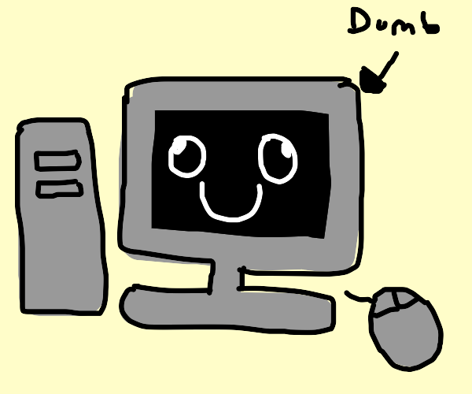
Issue
Tutoring is expensive
It can be difficult to find mentors
Issues in scheduling, location, personality
Online learning can be clunky
Often not personalized
Only a preset number of modules to choose from
Relies on older, classroom style learning
Speed of learning != speed of teaching

Slide 3
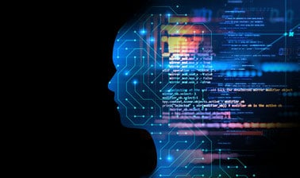
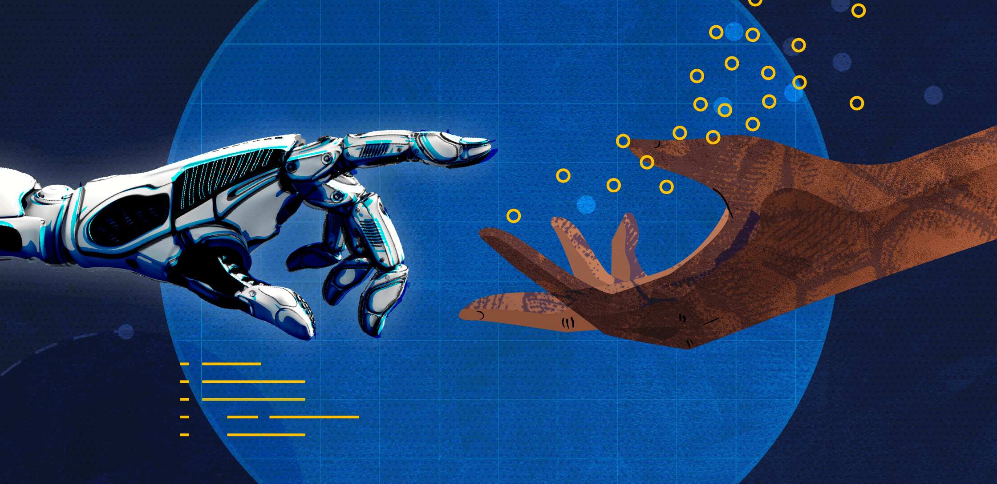
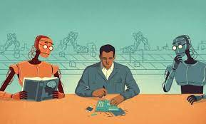
Solution: Machine Learning
Tutoring that works with you
Provides real-time feedback
Lets you model your style off of guides
Grows with you

Slide 4

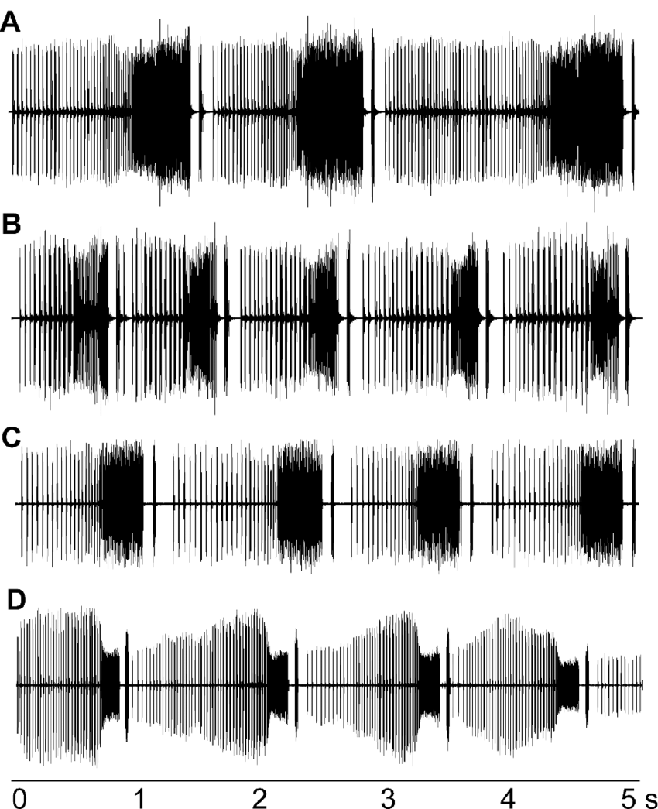
Case Study: Karaoke
Code scours millions of free songs with tags (“supervised” data)
High-level: genre, artist, male/female/other
Lower-level: tone, pitch, intensity, nasality, difficulty, wpm, length of notes, range, etc.
Eventually the computer would be sophisticated enough to create its own tags
Finds these patterns through their mathematical representation in the waveforms
Pattern → Math

Slide 5
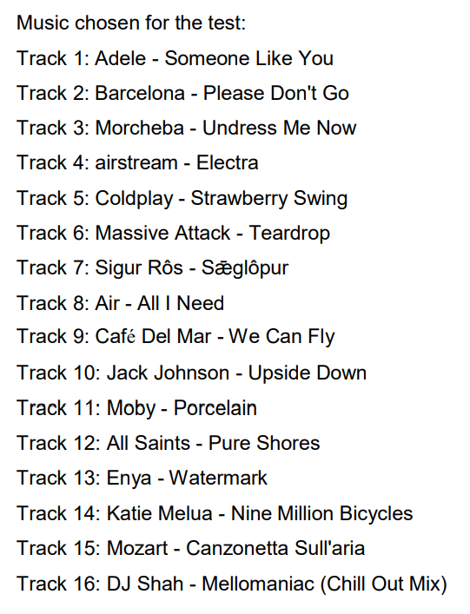
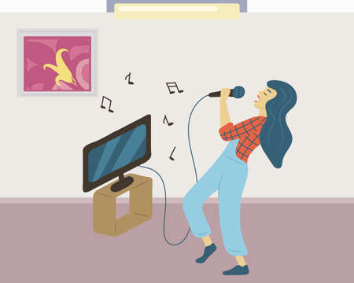
Case Study: Karaoke
User (Orpheus) sings into computer, and audioform is captured
Series of 5-10 songs of various characteristics
Computer searches database, finds artists whose voice most closely matches Orpheus
Finds songs that would be easiest to sing for their particular voice
Orpheus chooses some songs (could be outside this selection as well)

Slide 6
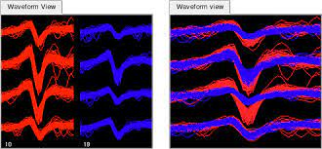
Case Study: Karaoke
Orpheus sings a song, computer overlaps his waveform with the actual song
Normalizes for volume, background noise, audio quality.
Mathematically finds differences, and translates back into physical representations
This line lasts longer on the waveform = hold this note longer
Pattern match at different timestep = too fast or too slow (autocorrelation)
Math → Patterns
Program graphically displays differences, highlighting what needs to be changed

Slide 7
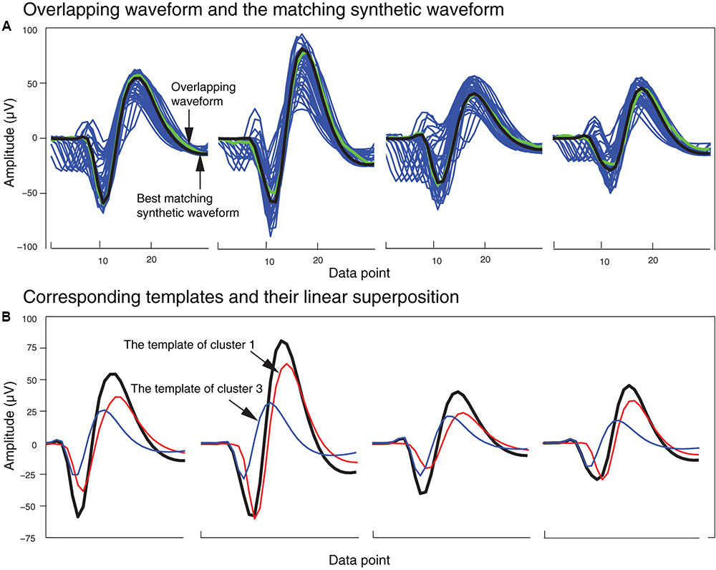
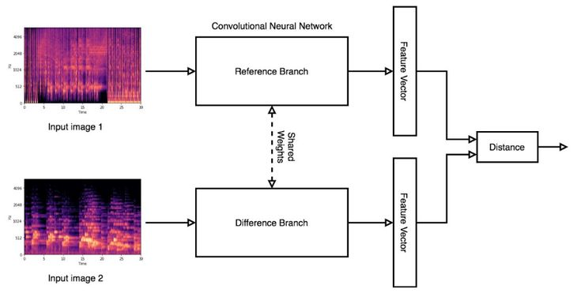

Slide 8
Case Study: Karaoke
Can offer:
continuous feedback
number showing how you are improving
how close you are to the original
and more
Program gets better as you use it more
Could even build an internal program which evaluates which methods of feedback produce the best results
Key is to always have visible representations of feedback
Utilize expert knowledge in construction of program and how to give feedback

Slide 9
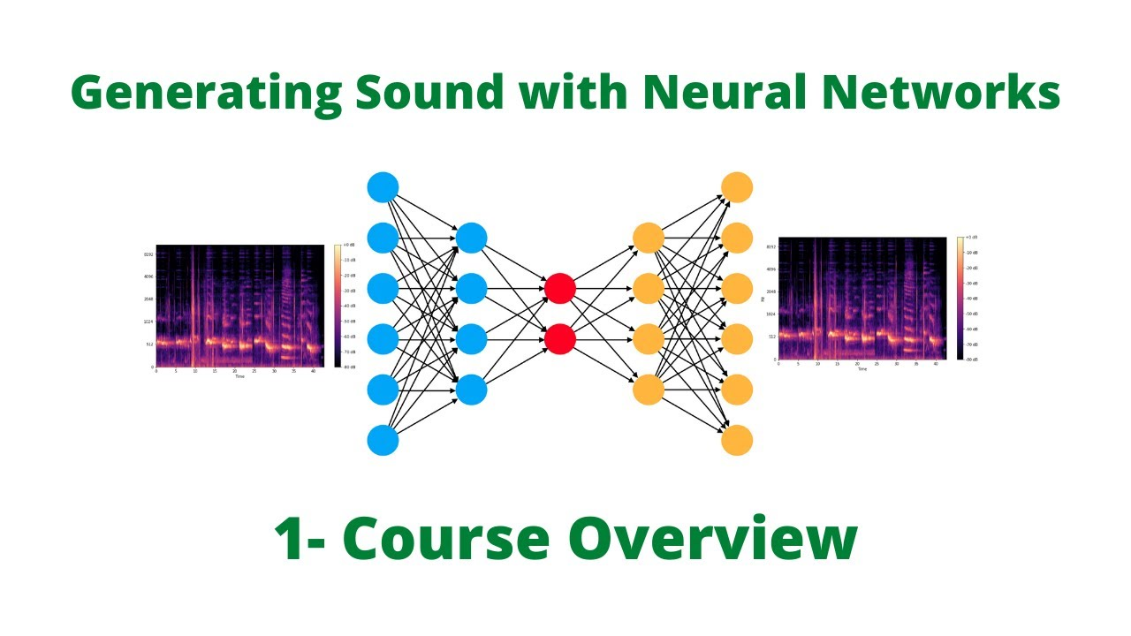

Uniqueness
The idea of a computer providing feedback is not unique, but marrying it with machine learning might be
Requires no knowledge of music to start
Constantly learning

Slide 10
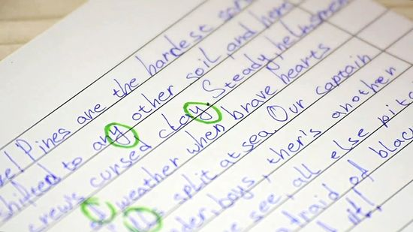
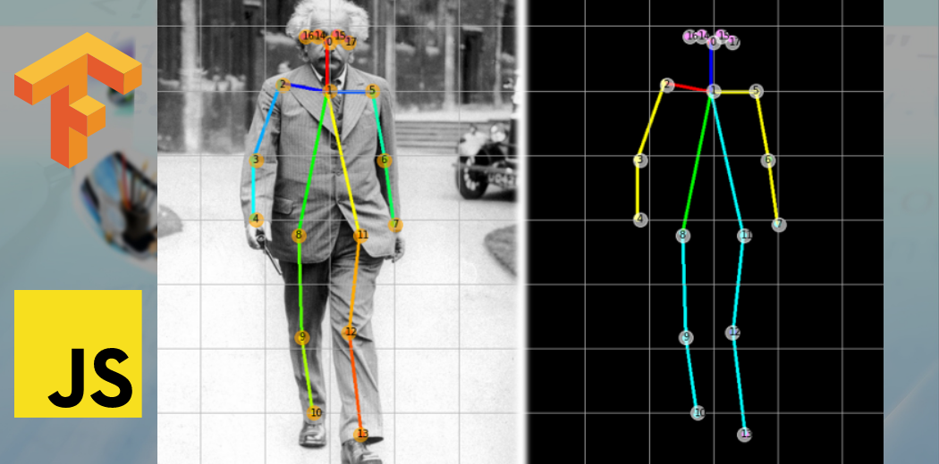
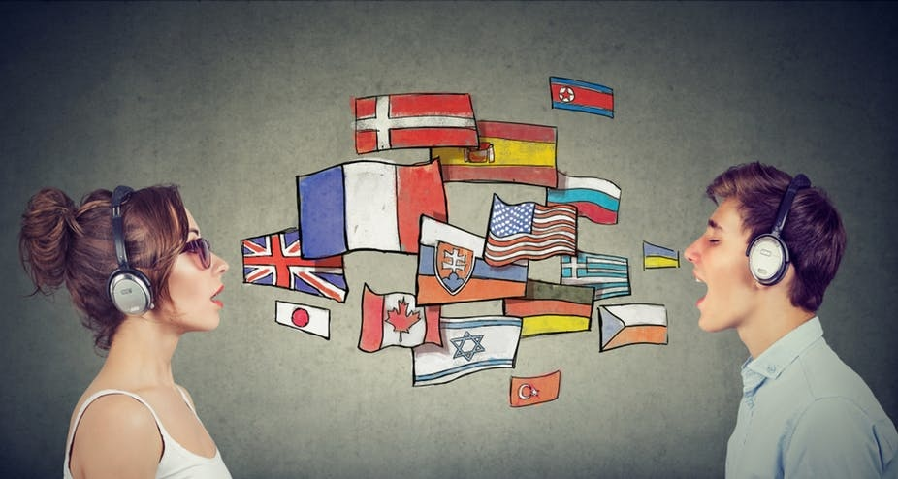
Other ventures
Hand-writing
Foreign language
Dance, yoga, home exercise
Speech therapy, accent training
Writing style
But this is creepy and I don’t like it

